Slide 1

人工智能实践
Artificial Intelligence Practice
DCS3015 Autumn 2022
Chao Yu （余超）
School of Computer Science and Engineering
Sun Yat-Sen University

Slide 2
Lecture：开悟平台介绍

Slide 3
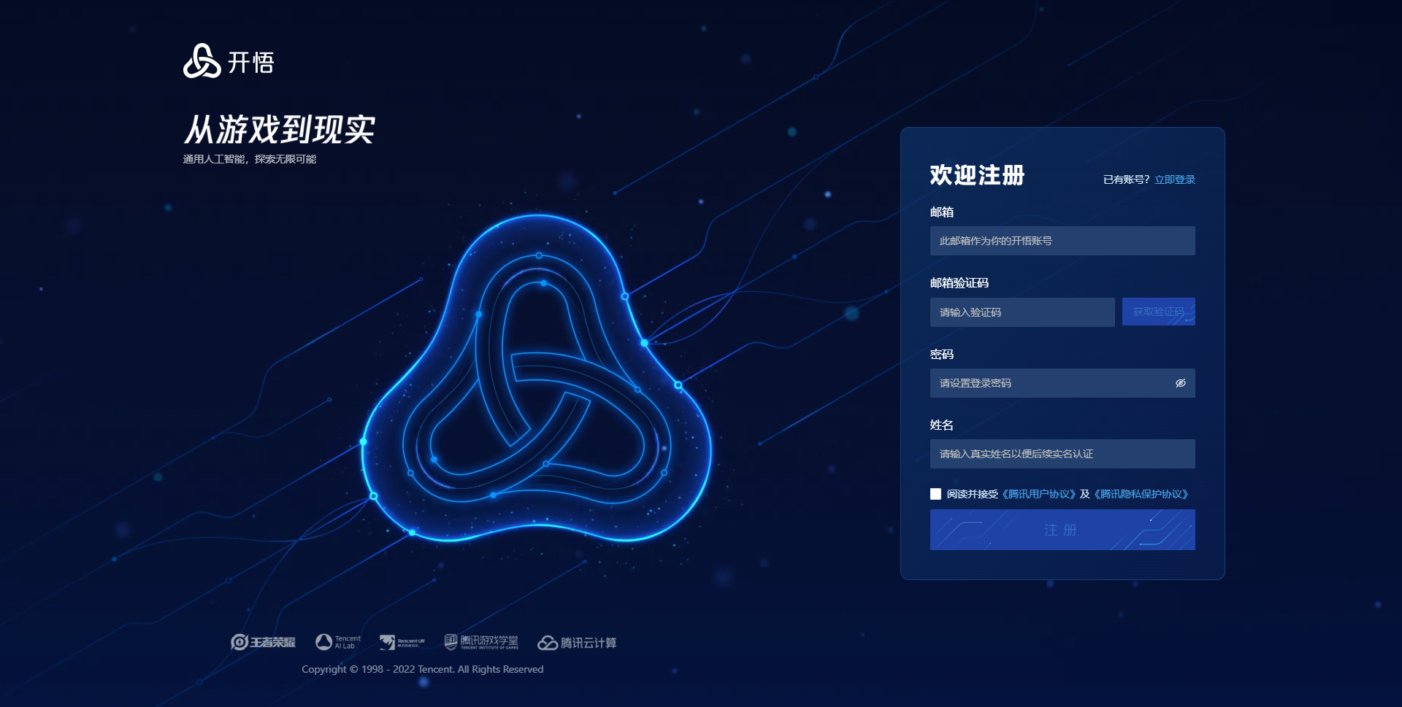
开悟平台介绍
开悟平台的使用
开悟官网注册账号

Slide 4
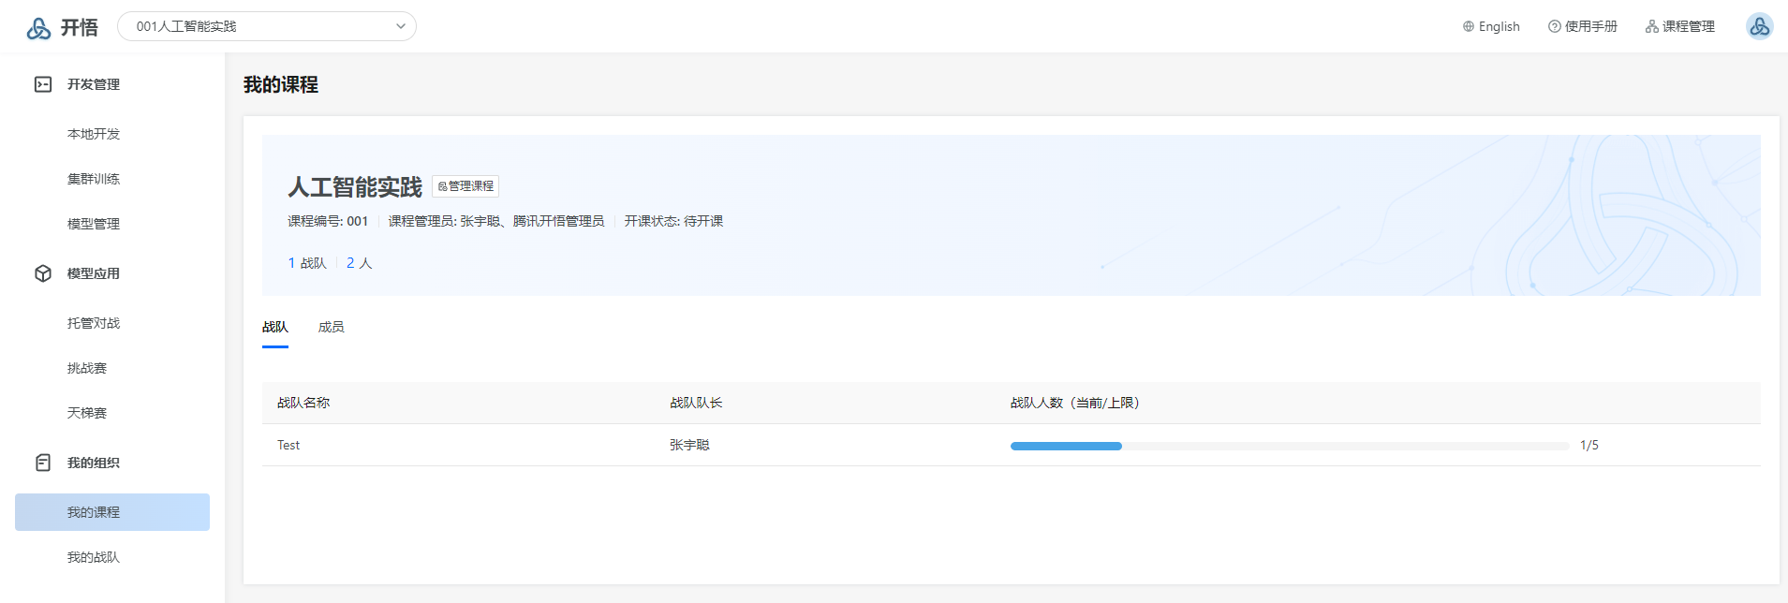
开悟平台介绍
开悟平台的使用
根据邀请链接加入课程
每五个人一个战队（自行分组）

Slide 5
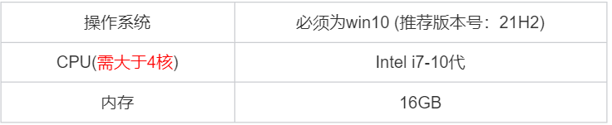
开悟平台介绍
开悟平台的使用
使用平台前需下载VS Code、docker、开悟客户端（后面会发使用说明文档）
设备要求：

Slide 6
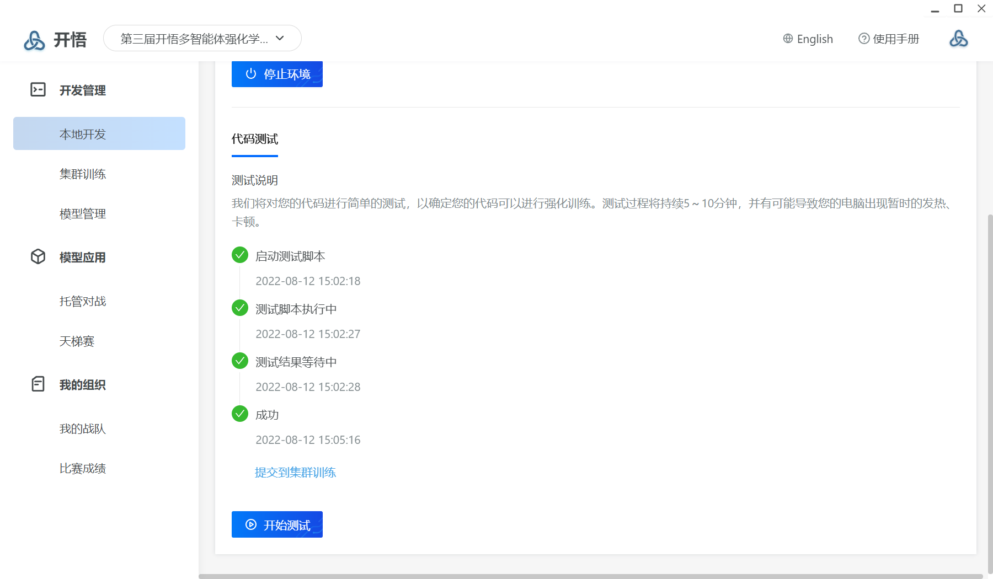
开悟平台介绍
开悟平台的使用
集群训练
本地开发
代码测试
提交集群训练
模型管理

Slide 7
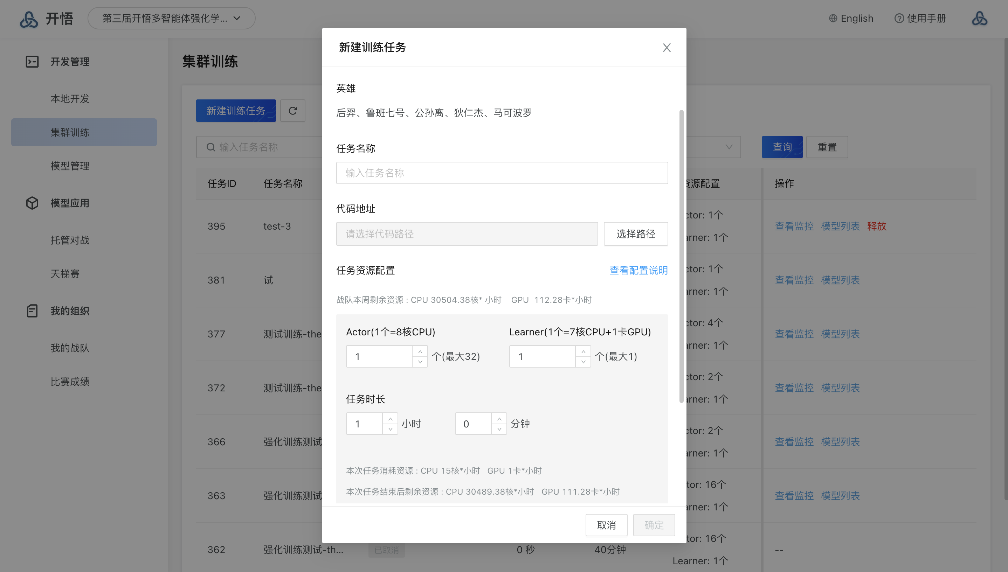
开悟平台介绍
开悟平台的使用
集群训练

Slide 8
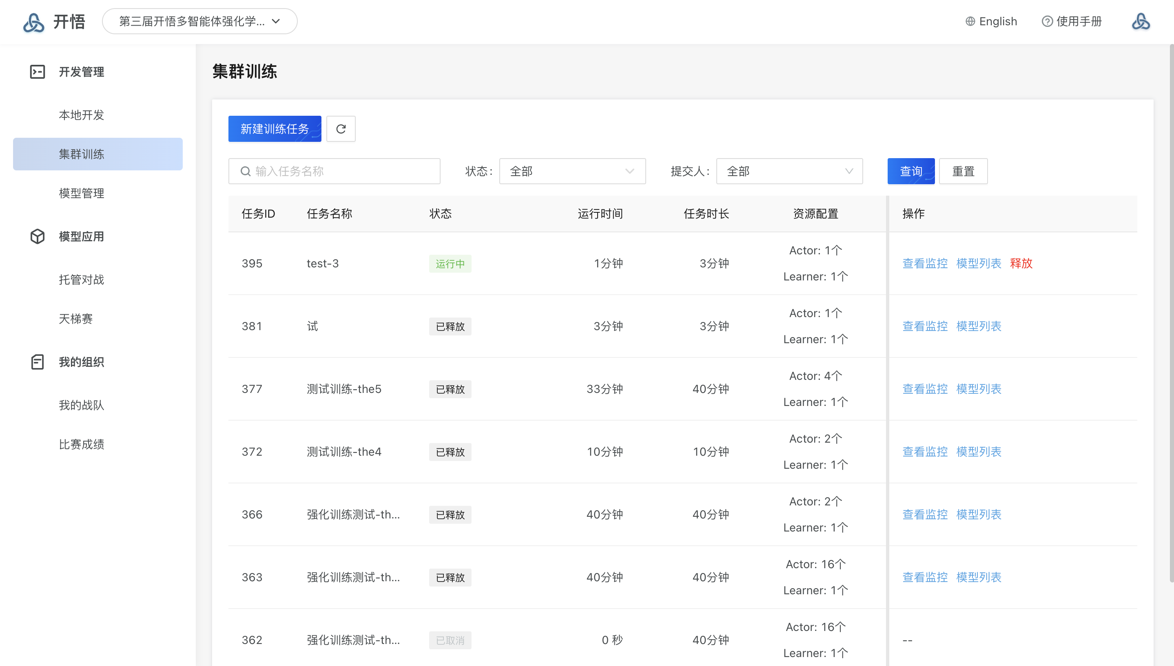
开悟平台介绍
开悟平台的使用
集群训练

Slide 9
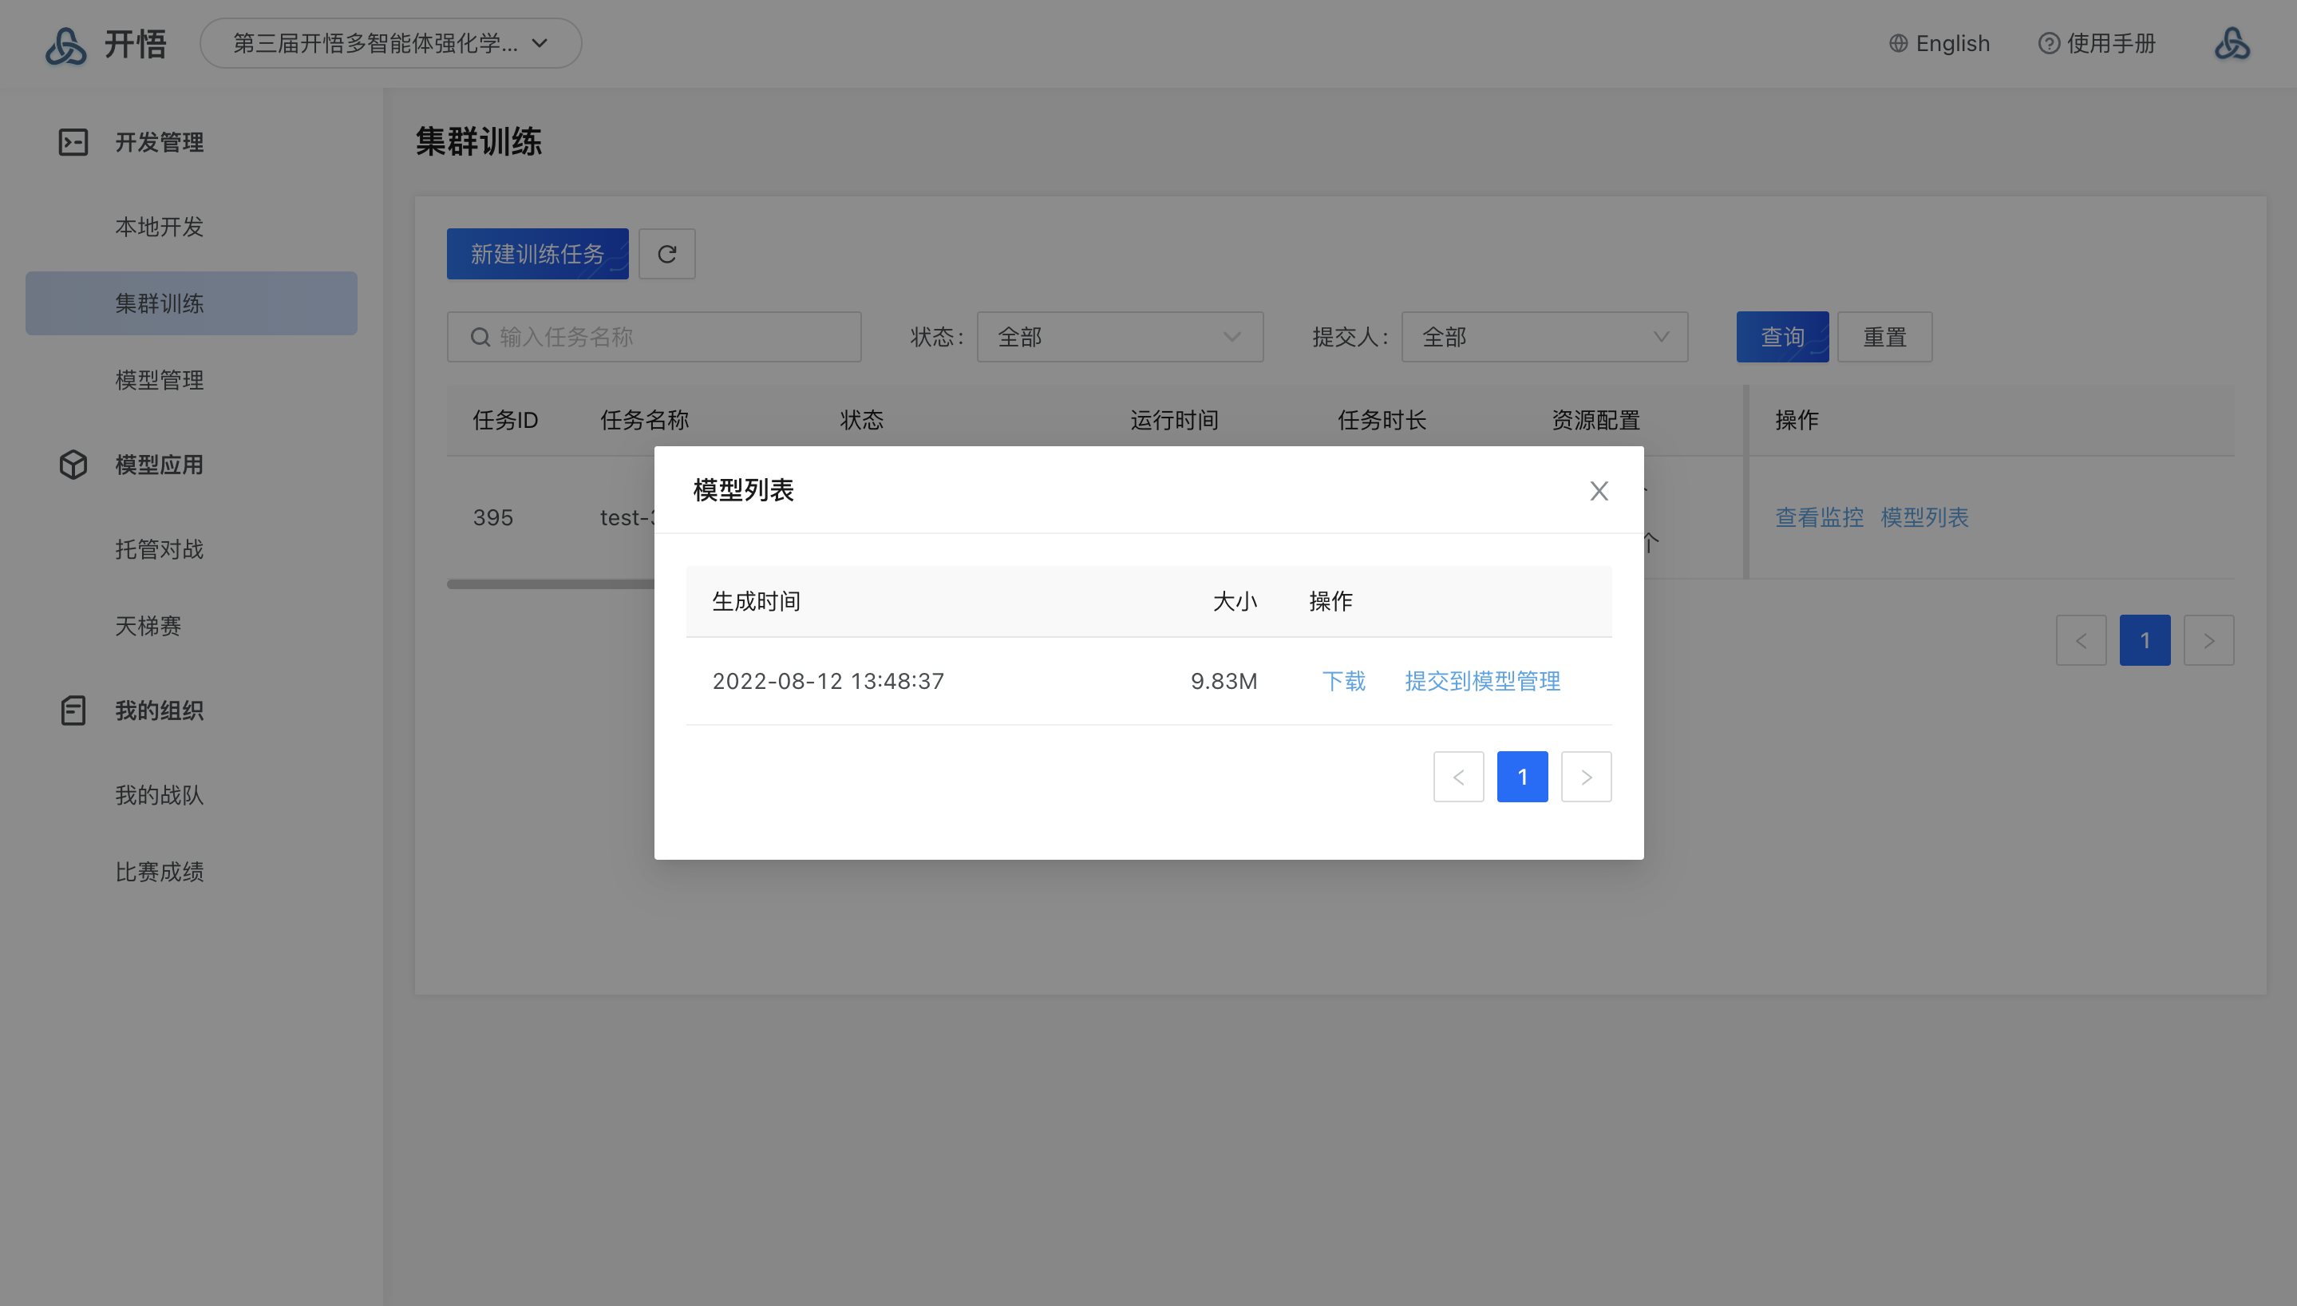
开悟平台介绍
开悟平台的使用
集群训练

Slide 10
开悟平台介绍
开悟平台的使用
开悟仅能使用TensorFlow深度学习框架（自行学习）
开悟平台提供三个功能模块检验模型能力
托管对战：用户可创建对战任务，使用自己的模型与课程中战队/管理员共享的模型进行对战。同样，也可以选择自己的不同模型进行对战。
挑战赛：在挑战赛中，课程成员的模型可与课程管理员指定的课程AI模型进行对战，并在比赛结束后获得成绩。
天梯赛：不同战队提交的模型会按照比赛设置进行循环对战，即每个战队提交的模型均会与其他所有战队提交的模型进行对战。比赛后会根据比赛胜场展示战队排名结果。

Slide 11
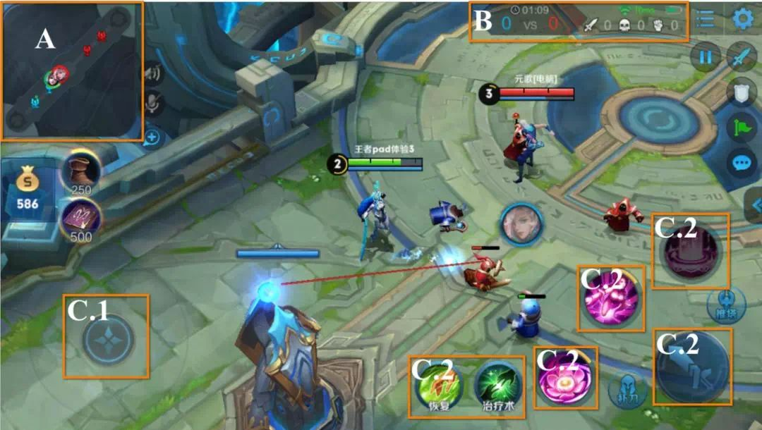
开悟平台介绍
Action Space设计：
移动键 Move（C1）
技能槽(C2)
1技能 Skill1（方向型）
2技能 Skill2（方向型）
3技能 Skill3（自身目标释放，例如貂蝉）
普通攻击 ComAttack（目标型）
智能体介绍
游戏单元：
英雄：友方英雄和敌方英雄
英雄基础属性，包含血量、蓝量、攻击力，防御力，抗性等
英雄技能，包含技能槽、技能CD，技能等级
小兵
包含小兵血量、位置等
塔
包含塔的位置、血量等特征

Slide 12
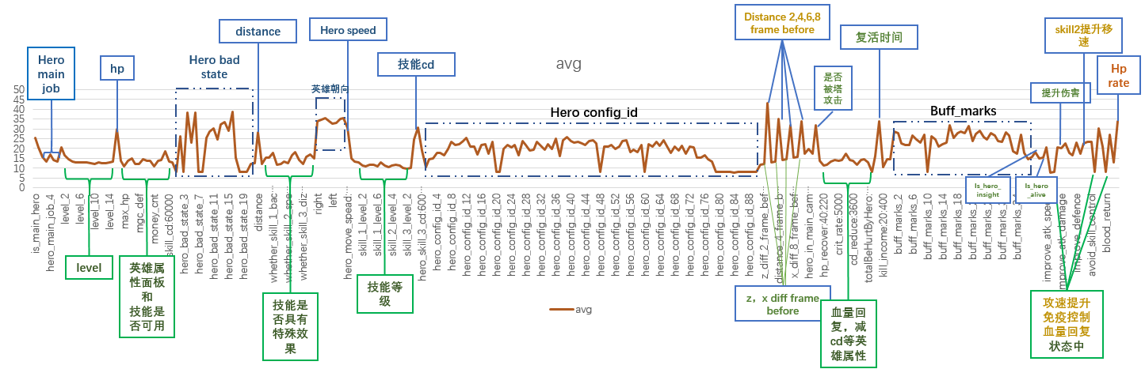
开悟平台介绍
智能体介绍
智能体观测：主英雄特征、友方、敌方、己方小兵、敌方小兵、己方塔、敌方塔、全局信息。
主英雄特征：

Slide 13
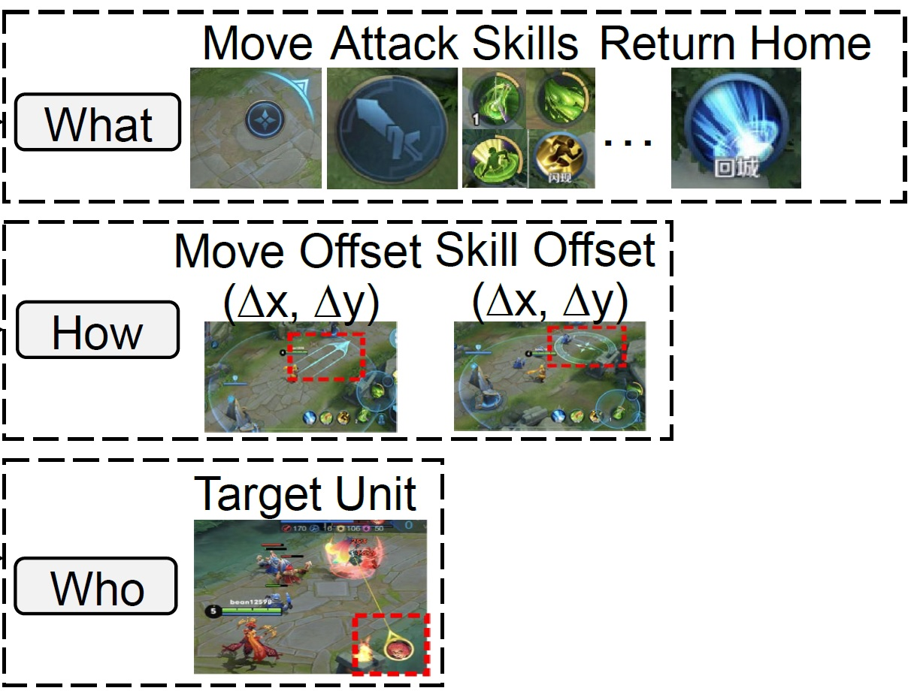
开悟平台介绍
智能体介绍
Action Space设计：
移动键 Move（C1）
技能槽(C2)
1技能 Skill1（方向型）
2技能 Skill2（方向型）
3技能 Skill3（自身目标释放，例如貂蝉）
普通攻击 ComAttack（目标型）
游戏中的动作设计
what，你要按哪个按键：12个button
how，你要往哪个方向拖动按键：16*16个方向选择
who，你的技能作用对象是谁：8个target（两塔，四兵，一个英雄，以及None）

Slide 14
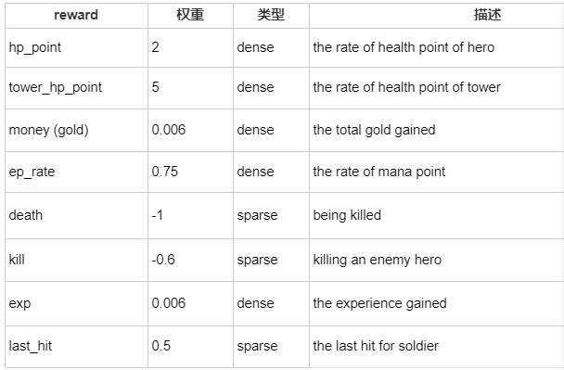
开悟平台介绍
智能体介绍
奖励值设计：

Slide 15
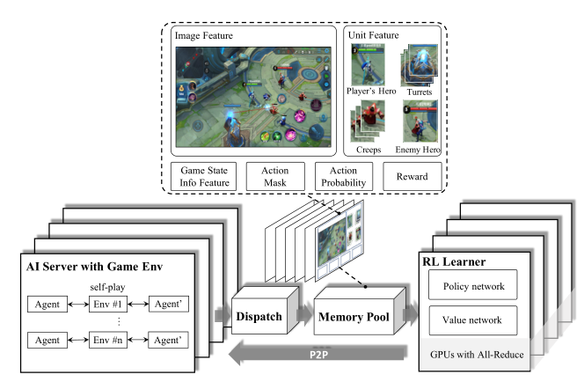
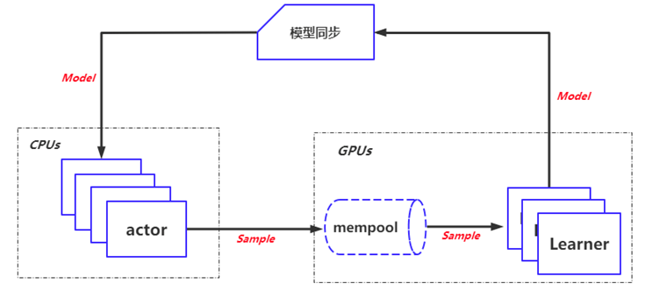

开悟平台介绍
集群训练
Actor
Model
Learner
1
自博弈生产数据
2
3
训练消费数据
生成模型 模型同步

Slide 16
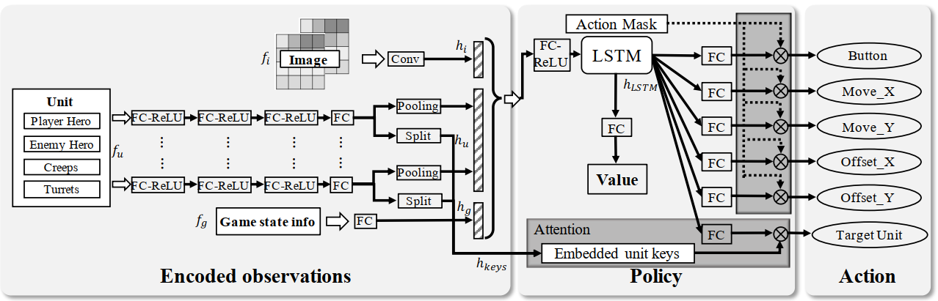
开悟平台介绍
官方代码
单智能体PPO算法
Multi-head Policy
Image输入和向量输入
Attention
参数共享
特征工程
Ye, Deheng, et al. "Mastering complex control in moba games with deep reinforcement learning." Proceedings of the AAAI Conference on Artificial Intelligence. Vol. 34. No. 04. 2020.

Slide 17
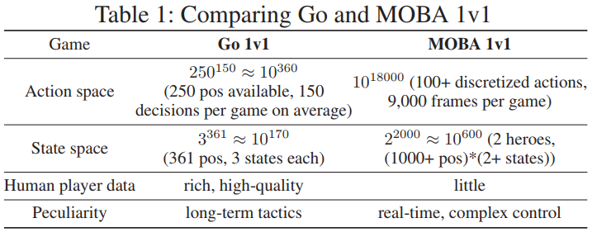
开悟平台介绍
论文介绍（Introduce）
It’s very difficult to search any policies with human-level performance in the Multi-player Online Battle Arena (MOBA) 1v1 games.
MOBA 1v1 is a real-time strategy (RTS) game that requires highly complex action control.
Ye, Deheng, et al. "Mastering complex control in moba games with deep reinforcement learning." Proceedings of the AAAI Conference on Artificial Intelligence. Vol. 34. No. 04. 2020.

Slide 18
开悟平台介绍
论文介绍（introduce）
The complexity of MOBA 1v1 also comes from the playing mechanism：
To win a game, in the partially observable environment, agents must learn to plan, attack, defend, control skill combos, induce, and deceive the opponents.
Apart from the player’s and the opponent’s agent, there exists many more game units, e.g., creeps and turrets. This creates challenge to the target selection which requires delicate sequences of decision making and corresponding action controls.
Different heroes in a MOBA game have very different playing methods. The action control can completely change from hero to hero, which calls for robust and unified modeling.
Ye, Deheng, et al. "Mastering complex control in moba games with deep reinforcement learning." Proceedings of the AAAI Conference on Artificial Intelligence. Vol. 34. No. 04. 2020.

Slide 19
开悟平台介绍
论文介绍（Method）
Considering the fact that complex agent control problems can introduce high variance of stochastic gradients, e.g. the MOBA 1v1 games, large batch size is necessary to speed up the training
Designing a scalable and loosely-coupled system architecture to construct the utility of data parallelism：
Reinforcement Learning (RL) Learner
Artificial Intelligence (AI) Server
Dispatch Module
Memory Pool
Ye, Deheng, et al. "Mastering complex control in moba games with deep reinforcement learning." Proceedings of the AAAI Conference on Artificial Intelligence. Vol. 34. No. 04. 2020.

Slide 20
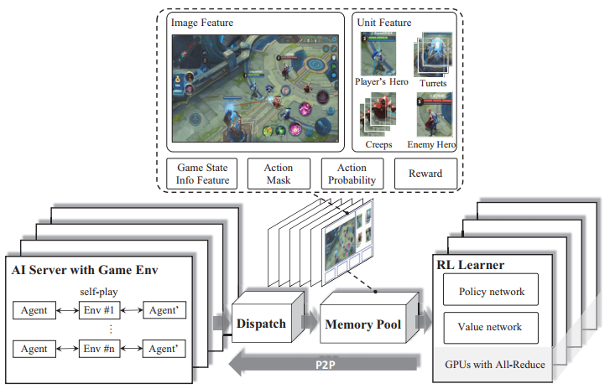
开悟平台介绍
论文介绍（Method）
Ye, Deheng, et al. "Mastering complex control in moba games with deep reinforcement learning." Proceedings of the AAAI Conference on Artificial Intelligence. Vol. 34. No. 04. 2020.

Slide 21
开悟平台介绍
论文介绍（Method）
Artificial Intelligence (AI) Server：
The AI Server implements how the AI model interacts with the environment. AI server covers the interaction logic between game environment and the AI model , and generates episodes via self-play with mirrored policies.
Dispatch Module
The Dispatch Module is a station for sample collection, compression and transmission. It is a server that collects data samples from AI Servers, consisting of reward, feature, action probabilities, etc.
Memory Pool
The Memory Pool is the data storage module, which provides training instances for the RL Learner. It supports samples of varied lengths, and data sampling based on the generated time.
Reinforcement Learning (RL) Learner
The RL Learner is a distributed training environment. The gradients in the RL learners are averaged through the ring allreduce algorithm.
Ye, Deheng, et al. "Mastering complex control in moba games with deep reinforcement learning." Proceedings of the AAAI Conference on Artificial Intelligence. Vol. 34. No. 04. 2020.

Slide 22
开悟平台介绍
论文介绍（Method）
Algorithm Design (Novel Strategies)：
The target attention mechanism is designed in this network to help with the target selection in MOBA combats.
LSTMs are leveraged for the hero to learn the skill combos which are critical to create severe and instant damage
The decoupling of control dependencies is conducted to form a multi-label proximal policy optimization (PPO) objective
A game-knowledge-based pruning method, called action mask, is developed to guide explorations during the reinforcement process
A dual-clipped version of the PPO algorithm is proposed to guarantee convergence with large and deviated batches
Ye, Deheng, et al. "Mastering complex control in moba games with deep reinforcement learning." Proceedings of the AAAI Conference on Artificial Intelligence. Vol. 34. No. 04. 2020.

Slide 23
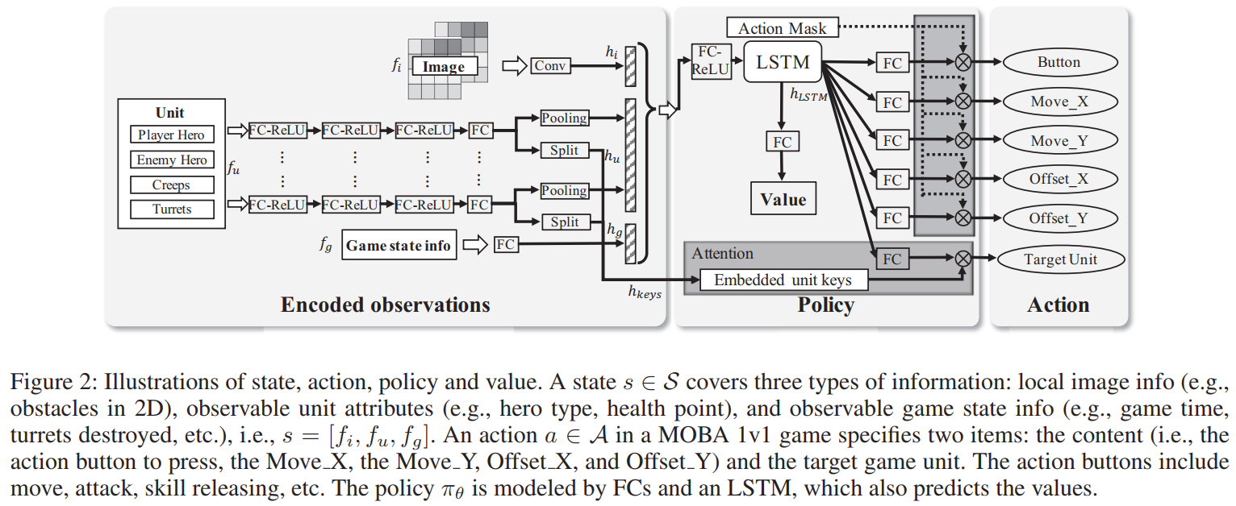
开悟平台介绍
论文介绍（Method）
Algorithm Design：
In the RL Learner, an actor-critic network is implemented to model the action control dependencies in MOBA 1v1 games.
Ye, Deheng, et al. "Mastering complex control in moba games with deep reinforcement learning." Proceedings of the AAAI Conference on Artificial Intelligence. Vol. 34. No. 04. 2020.

Slide 24
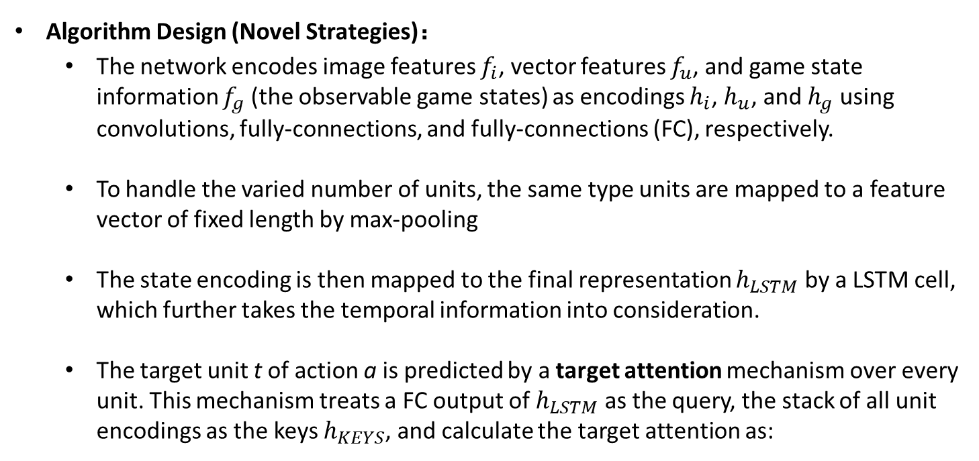
开悟平台介绍
论文介绍（Method）
Algorithm Design (Novel Strategies)：
The network encodes image features $f_{i}$, vector features $f_{u}$, and game state information $f_{g}$ (the observable game states) as encodings $h_{i}$, $h_{u}$, and $h_{g}$ using convolutions, fully-connections, and fully-connections (FC), respectively.
To handle the varied number of units, the same type units are mapped to a feature vector of fixed length by max-pooling
The state encoding is then mapped to the final representation $h_{LSTM}$ by a LSTM cell, which further takes the temporal information into consideration.
The target unit t of action a is predicted by a target attention mechanism over every unit. This mechanism treats a FC output of $h_{LSTM}$ as the query, the stack of all unit encodings as the keys $h_{KEYS}$, and calculate the target attention as:
Ye, Deheng, et al. "Mastering complex control in moba games with deep reinforcement learning." Proceedings of the AAAI Conference on Artificial Intelligence. Vol. 34. No. 04. 2020.

Slide 25
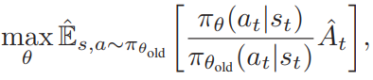
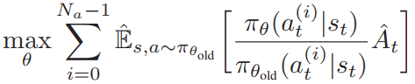
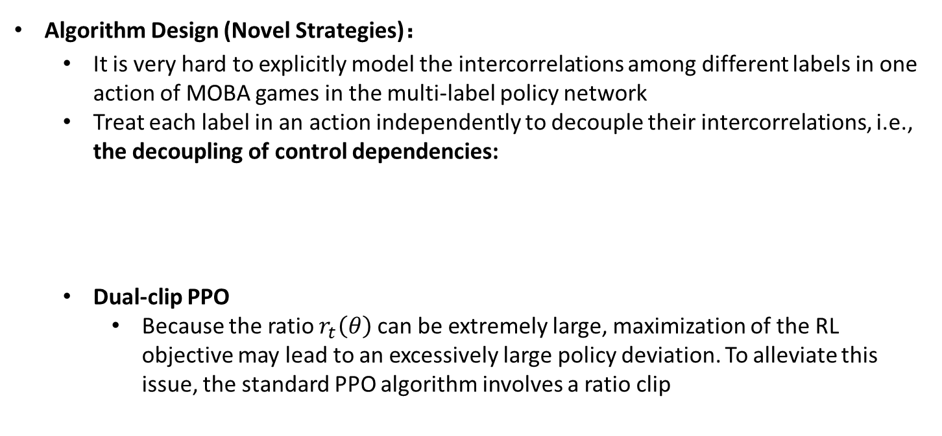
开悟平台介绍
论文介绍（Method）
Algorithm Design (Novel Strategies)：
It is very hard to explicitly model the intercorrelations among different labels in one action of MOBA games in the multi-label policy network
Treat each label in an action independently to decouple their intercorrelations, i.e., the decoupling of control dependencies:
Dual-clip PPO
Because the ratio $r_{t}\left(θ\right)$ can be extremely large, maximization of the RL objective may lead to an excessively large policy deviation. To alleviate this issue, the standard PPO algorithm involves a ratio clip
Ye, Deheng, et al. "Mastering complex control in moba games with deep reinforcement learning." Proceedings of the AAAI Conference on Artificial Intelligence. Vol. 34. No. 04. 2020.

Slide 26
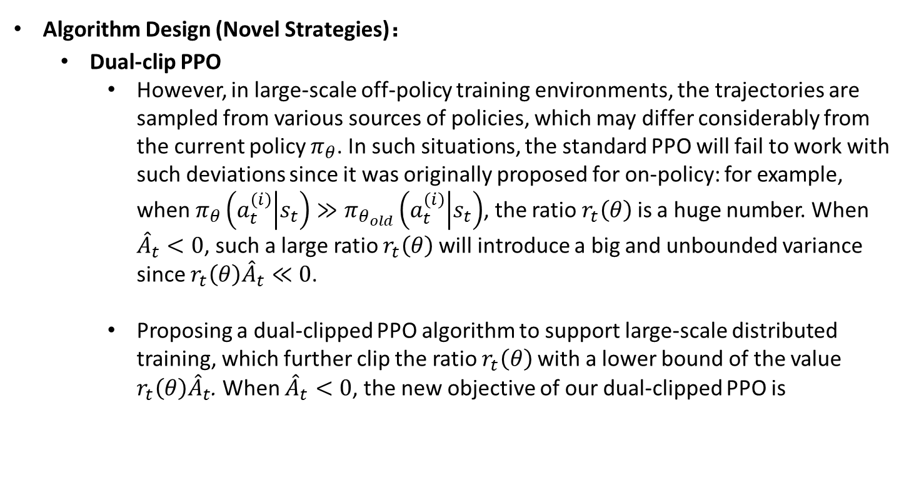
开悟平台介绍
论文介绍（Method）
Algorithm Design (Novel Strategies)：
Dual-clip PPO
However, in large-scale off-policy training environments, the trajectories are sampled from various sources of policies, which may differ considerably from the current policy $π_{θ}$. In such situations, the standard PPO will fail to work with such deviations since it was originally proposed for on-policy: for example, when $π_{θ}\left(a_{t}^{\left(i\right)} | s_{t}\right)≫π_{θ_{old}}\left(a_{t}^{\left(i\right)} | s_{t}\right)$, the ratio $r_{t}\left(θ\right)$is a huge number. When ${\hat{A}}_{t}<0$, such a large ratio $r_{t}\left(θ\right)$will introduce a big and unbounded variance since $r_{t}\left(θ\right){\hat{A}}_{t}≪0$.
Proposing a dual-clipped PPO algorithm to support large-scale distributed training, which further clip the ratio $r_{t}\left(θ\right)$with a lower bound of the value $r_{t}\left(θ\right){\hat{A}}_{t}$. When ${\hat{A}}_{t}<0$, the new objective of our dual-clipped PPO is
Ye, Deheng, et al. "Mastering complex control in moba games with deep reinforcement learning." Proceedings of the AAAI Conference on Artificial Intelligence. Vol. 34. No. 04. 2020.

Slide 27
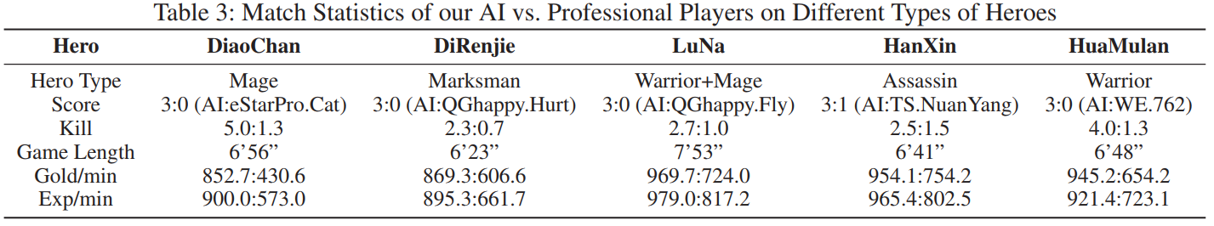
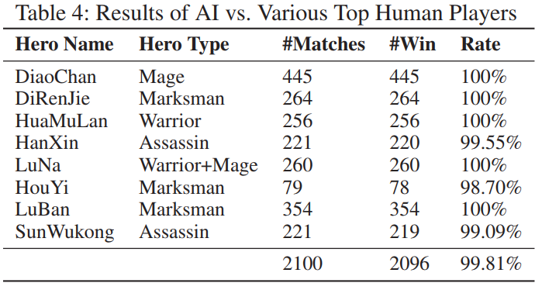
开悟平台介绍
论文介绍（Method）
Algorithm Design (Results)：
Ye, Deheng, et al. "Mastering complex control in moba games with deep reinforcement learning." Proceedings of the AAAI Conference on Artificial Intelligence. Vol. 34. No. 04. 2020.

Slide 28
Thanks

